Slide 1
Testing of Hypothesis for Small Samples(Exact Sample Test)
t-TEST

Slide 2
t-test:
When the sample size is small (traditionally it is assumed less than or equal to 30), then the sampling distribution of the sample mean is assumed to be follow student’s t-distribution. The t distribution is also similar to normal distribution having shape as in normal distribution but little bit flatter.

Slide 3
Assumption of t-test:
The sample size is less than i.e (n< 30)
The parent population from which the sample is drawn is normal.
The population standard deviation (σ) is unknown.
The samples are independent and are drawn by random sampling method.

Slide 4
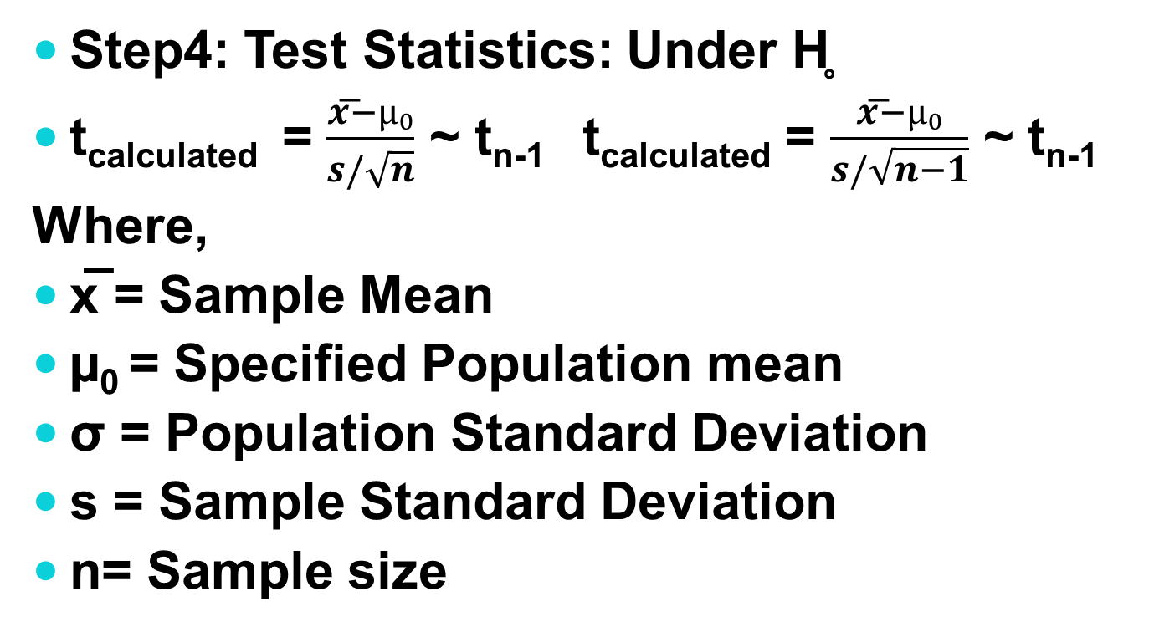
Case I: Test of Significance of a Single Mean:
Step4: Test Statistics: Under H̥
t_{calculated} = $\frac{x͞−µ₀}{s/\sqrt{n}}$ ~ t_{n-1} t_{calculated} = $\frac{x͞−µ₀}{s/\sqrt{n−1}}$ ~ t_{n-1}
Where,
x̅ = Sample Mean
µ₀ = Specified Population mean
σ = Population Standard Deviation
s = Sample Standard Deviation
n= Sample size

Slide 5
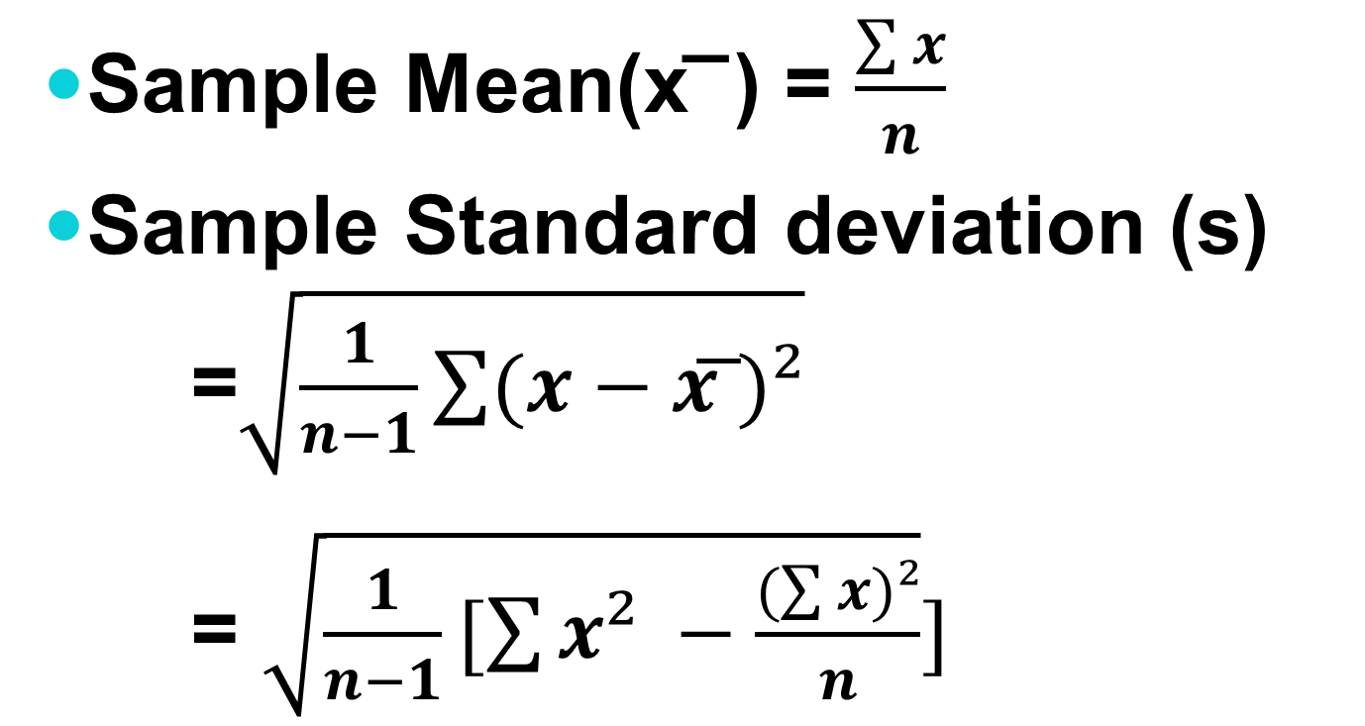
Con……….
Sample Mean(x͞ ) = $\frac{\sum{x}}{n}$
Sample Standard deviation (s) =$\sqrt{\frac{1}{n−1}\sum{(x−x͞ )²}}$
= $\sqrt{\frac{1}{n−1}[\sum{x² −\frac{(\sum{x)²}}{n}}}]$

Slide 6
Problems:
The height of 10 males of a given locality are found to be 70, 67, 62,68, 61, 68, 70, 64, 64, 66, inches. Is it reasonable to believe that the average height is greater than 64 inches? Test at 5% level of significance.
The prices of shares of a development bank on different days of a month were found to be 690, 710, 630, 700, 660, 650, 690, and 700. Test at 5% level of significance whether the mean price of the shares in the month is Rs. 650.

Slide 7
Problems:
3. A spark plug manufacturer claimed that its plug have a mean life in excess of 22100 miles. Assume that the life of the spark plugs follows the normal distribution. A fleet owner purchased a larger number of sets. A sample of 18 sets revealed that the mean life was 23400 miles and standard deviation was 1500 miles. Is there enough evidence to substantiate the manufacturer’s claim at the 0.05 significance level?

Slide 8
Problems:
4. A random sample of size 16 has the sample mean 53. The sum of the squares of deviation taken from the mean value is 150. Can this sample be regarded as taken population having 56 as its mean at 0.01 significance level?
5. A manufacturer intends that his electric light bulbs have a life of 1000 hrs. He tests a sample of 20 bulbs, drawn at random from a batch, and discovers that the mean life of the sample bulbs is 990 hours with a standard deviation of 22 hrs. Does this signify that the batch is not up to the standard?

Slide 9
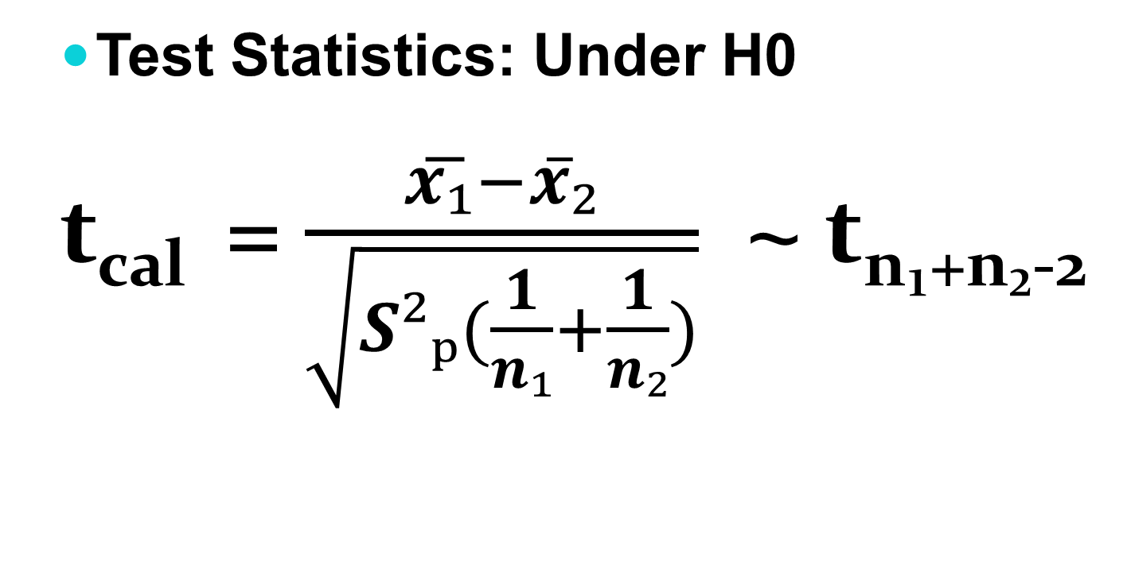
Case II: Test of Significance of Difference between Two means:
Test Statistics: Under H0
t_{cal} = $\frac{x͞₁−x̅₂}{\sqrt{S²ₚ(\frac{1}{n₁}+\frac{1}{n₂})}}$ ~ t_{n₁+n₂-2}

Slide 10
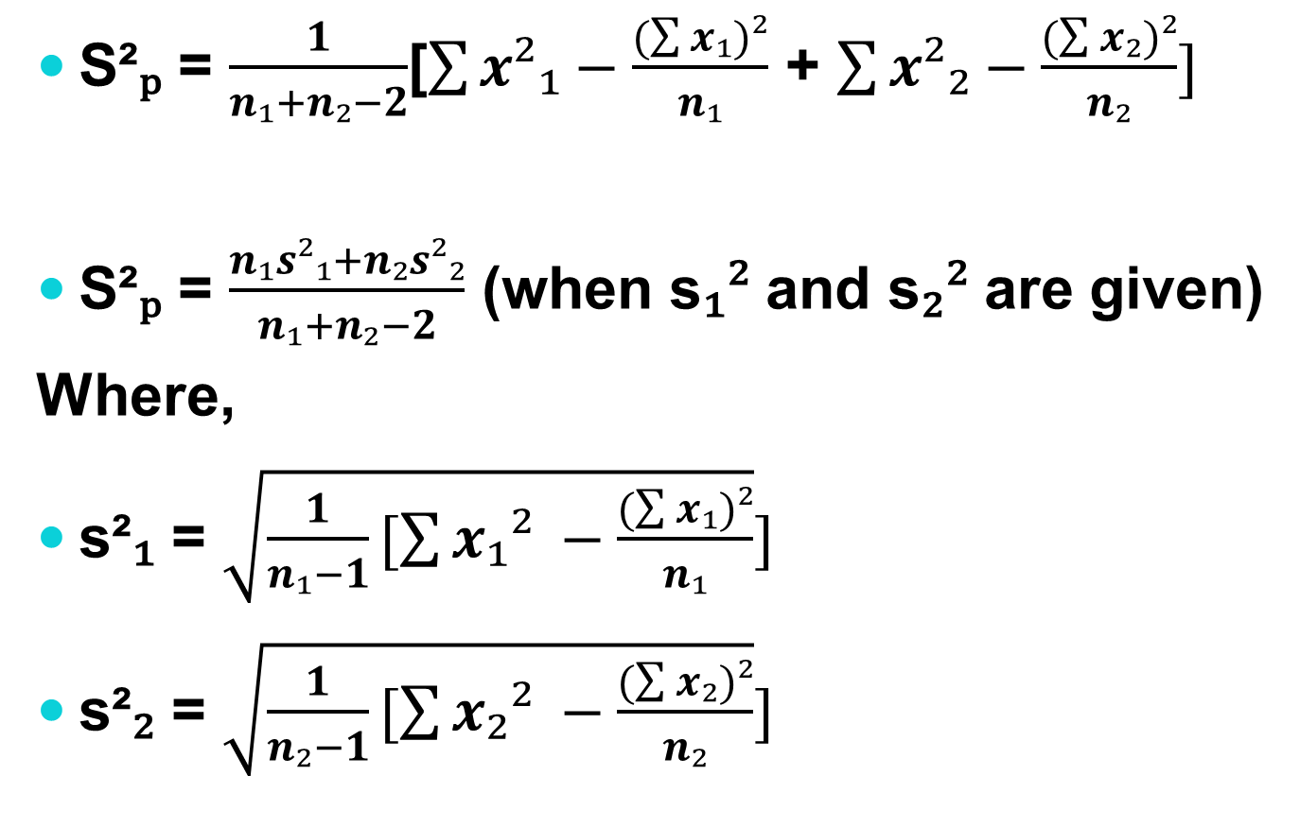
Conti……
S²ₚ = $\frac{1}{n₁+n₂−2}$[$\sum{x²₁−\frac{(\sum{x₁)²}}{n₁}}$ + $\sum{x²₂−\frac{(\sum{x₂)²}}{n₂}}]$
S²ₚ = $\frac{n₁s²₁+n₂s²₂}{n₁+n₂−2}$ (when s₁² and s₂² are given)
Where,
s²₁ = $\sqrt{\frac{1}{n₁−1}[\sum{x₁² −\frac{(\sum{x₁)²}}{n₁}}}]$
s²₂ = $\sqrt{\frac{1}{n₂−1}[\sum{x₂² −\frac{(\sum{x₂)²}}{n₂}}}]$

Slide 11
Problems:
Samples of two types of electric bulbs were tested for length of life and following data were obtained:
Is there difference in the means sufficient to warrant that type I is superior to Type II regarding length of life?
 | Type I | Type II
Sample No. | 8 | 7
Sample means | 1234 hours | 1036 hours
Sample S.D. | 36 hours | 40 hours

Slide 12
Problems:
2.The mean life of a sample of 10 electric bulbs was found to be 1456 hours with a standard deviation of 423 hours. A second sample of 17 bulbs chosen from different batch showed a mean life chosen from a different batch showed a mean life of 1280 hours with a standard deviation of 398 hours. Is there significant difference between the means of two batches?

Slide 13
Problems:
3. Two different types of drugs D1 and D2 were administered on certain patients for increasing weight at interval of one week time period. From the following observation, can you conclude that the second drug is more effective in increasing weight, use 1% level of significance.?
D1 | 8 | 12 | 13 | 9 | 3 | 8 | 10 | 9
D2 | 10 | 8 | 12 | 15 | 6 | 11 | 12 | 12

Slide 14
Case III: Paired t- Test (Dependent Samples):
Analysis steps for applying paired t-test:
Step1: Null hypothesis(Hₒ): µₓ =µ_{y} i.e. there is no significance difference in the observation before and after treatment or, the treatment is not effective
Step2: Alternative hypothesis(H₁): µₓ ≠µ_{y} i.e. there is significance difference in the observation before and after treatment. Or the treatment is effective
H₁: µₓ > µ_{y} (right tailed test) i.e. the treatment is effective.
H₁: µₓ <µ_{y} (left tailed test) i.e. the treatment is effective.

Slide 15
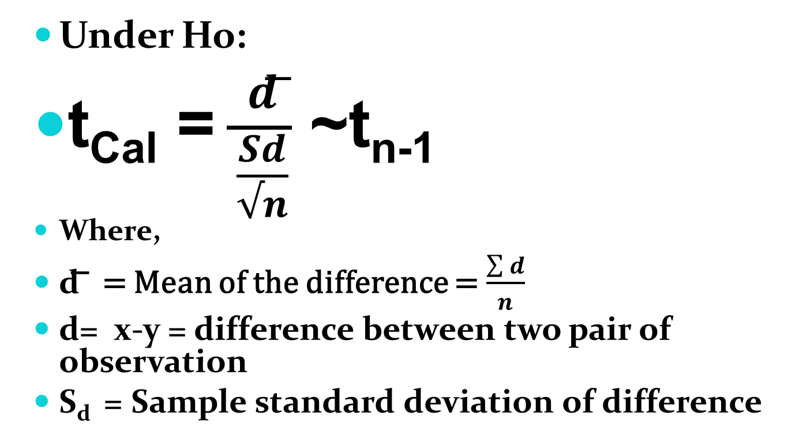
Test statistic:
Under Ho:
t_{Cal} = $\frac{d͞}{\frac{Sd}{√n}}$ ~t_{n-1}
Where,
d͞ = Mean of the difference = $\frac{\sum{d}}{n}$
d= x-y = difference between two pair of observation
S_{d} = Sample standard deviation of difference

Slide 16
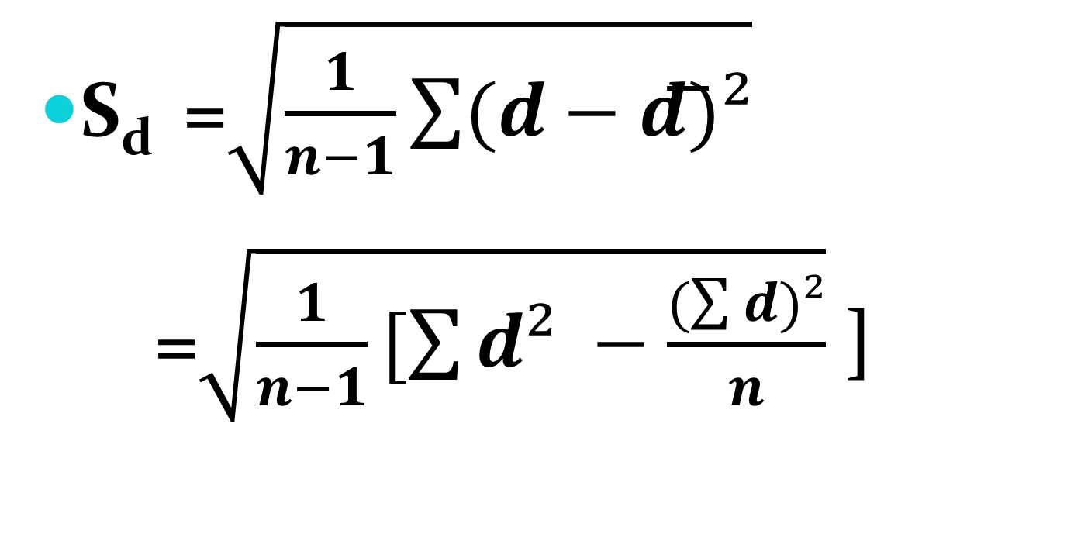
Sample standard deviation (S_{d} )
S_{d} =$\sqrt{\frac{1}{n−1}\sum{(d−d͞)²}}$
=$\sqrt{\frac{1}{n−1}[\sum{d² −\frac{(\sum{d)²}}{n}}}$ ]

Slide 17
Problems:
An I.Q. test was administered to 5 persons before and after they were given the nourishing food Horlicks. The results are given below.
Test whether there is increase in I.Q. after the Horlicks at 1% level of significance.
Candidates | I | II | III | IV | V
I.Q. before Horlicks | 110 | 120 | 123 | 132 | 125
I.Q. after Horlicks | 120 | 118 | 125 | 136 | 121

Slide 18
Problems:
2. Marks of 8 students before tuition and after tuition is given below;
Can you conclude that tuition has benefited the students?
Individuals | I | II | III | IV | V | VI | VII | VIII
Before tuition | 50 | 54 | 52 | 53 | 48 | 51 | 53 | 54
After tuition | 54 | 57 | 54 | 55 | 52 | 56 | 56 | 55

Slide 19
Problems:
3. In a manufacturing company the new modern manager is in a belief that music enhances the productivity of the workers. He made observation on eight workers for a week and recorded the production before and after music was installed. From the data given below can one conclude that productivity has been increased due to music.
Employee | 1 | 2 | 3 | 4 | 5 | 6 | 7 | 8
Without music | 220 | 202 | 226 | 190 | 200 | 215 | 208 | 210
With music | 236 | 190 | 240 | 200 | 220 | 205 | 212 | 215

Slide 20
Problems:
A drug administered to each of the 10 patients resulted in the following change of blood pressure:
3, 2,6,-2,1,0,-3,4,5,-1
Can it be considered that the drug no effect on change in blood pressure.

Slide 21
